Slide 1
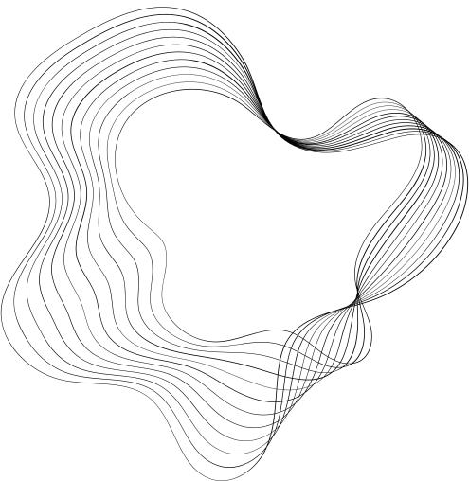

GROUP 5
SPA/SALON
Lomosco, Jomar T.
Palisoc, Joshua L.
Pasaan, Renan C.
Danias, Jerald A.
Vergara, Erren C.

Slide 2
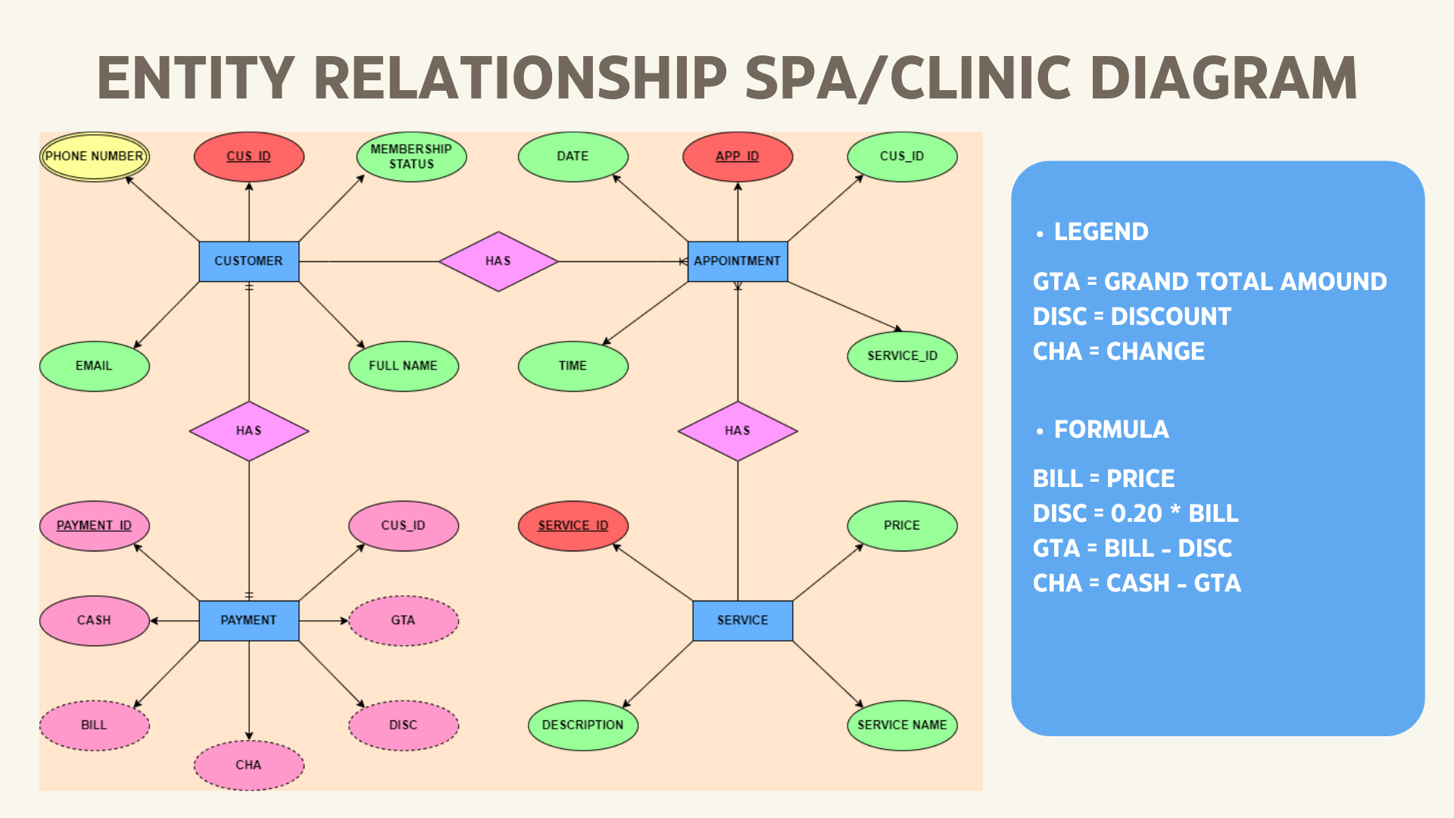
ENTITY RELATIONSHIP SPA/SALON DIAGRAM

Slide 3
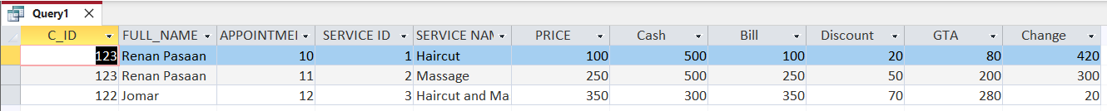
QUERY

Slide 4
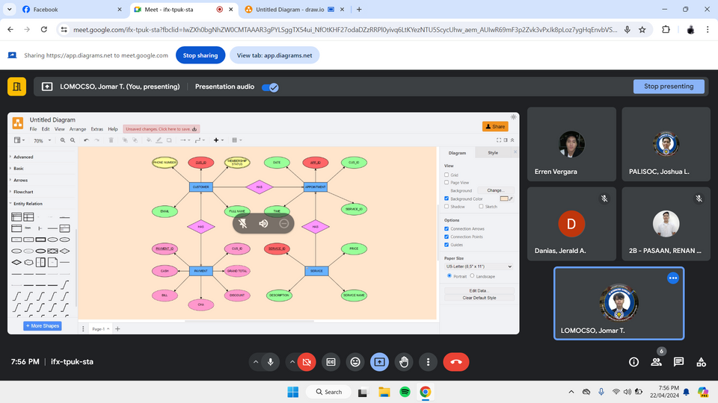
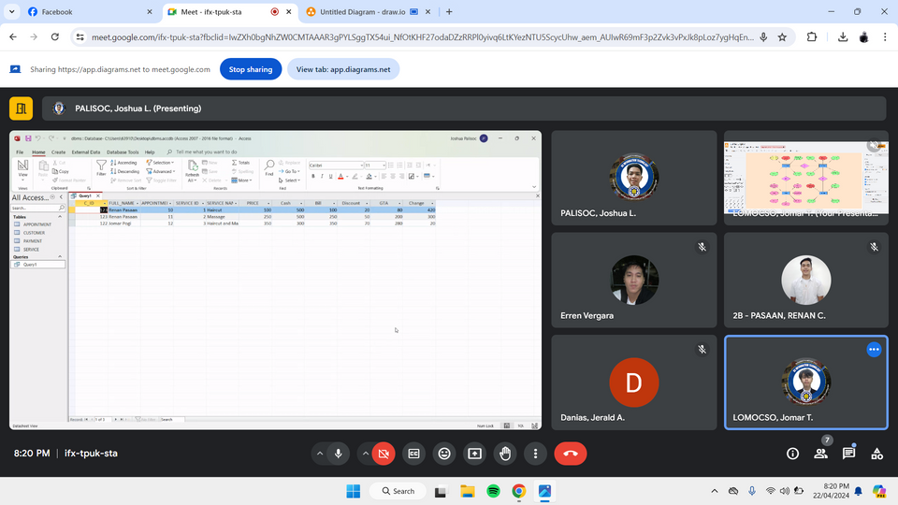
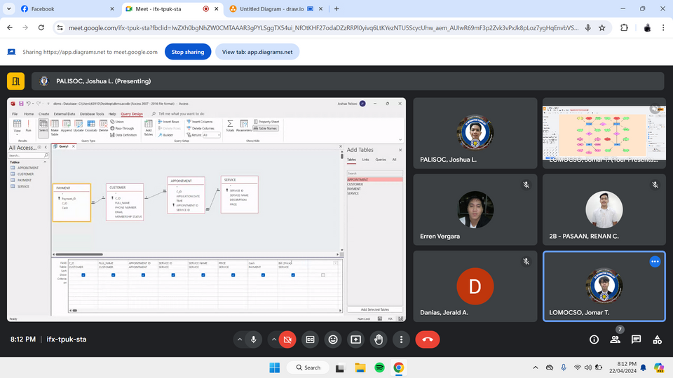
SCREENSHOT

